Slide 1
IoT-Based Electric Voting Machine Candidate Selection Platform
B Tech CSE-IoT (4th year)
Brijesh Nishad : 2101321550026
Ashutosh : 2101321550021
Aayush Pandey : 2101321550001
Submitted to
Mr. Rajat Kishor Varshney
October 2024

Slide 2
Introduction
This document outlines the design, implementation, and setup of an election voting machine that includes fingerprint authentication, candidate selection, and real-time vote monitoring through a web interface built with React. The hardware components consist of a fingerprint scanner, ESP32 microcontroller, and Arduino, while the software architecture allows for real-time updates
Background : The significance of secure voting systems cannot be overstated in today’s democratic processes. This project aims to enhance the security and efficiency of elections.
Motivation : The motivation behind this project is to address vulnerabilities in traditional voting systems and ensure that elections are conducted fairly and transparently

Slide 3

 | We are designing a EVM candidate selection machine for institute
 | Introducing an IoT-based EVM with enhanced security features.
 | Fingerprint and token based authentication
Overview
Brief overview of the project
Importance of secure and efficient candidate selection process in colleges

Slide 4
Traditional EVMs
Security Concerns:
Tampering Risks: Physical access to EVMs can lead to manipulation of vote counts.
Software Vulnerabilities: Flaws in the software can be exploited, potentially leading to vote miscounts.
Lack of Transparency:
Auditability Issues: Many traditional EVMs do not provide a paper trail for verifying results, making audits challenging.
Complexity: The technology is not easily understood by the general public, raising trust issues.

Slide 5
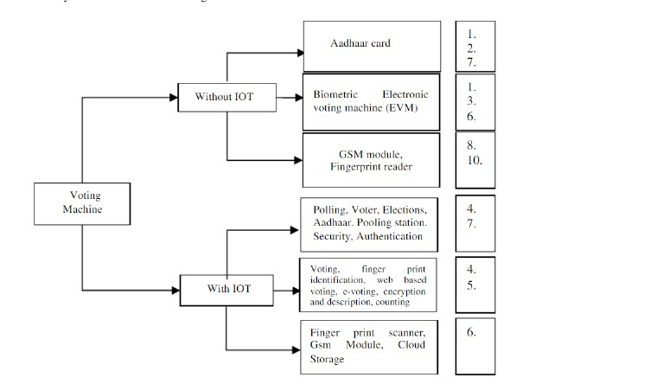
Flow Chart

Slide 6
IoT Based EVMs
Enhanced Security:
Real-Time Monitoring: Continuous tracking of voting machines can help detect tampering or anomalies immediately.
Decentralized Data Storage: Votes can be stored across multiple nodes, reducing the risk of single points of failure.
Improved Transparency:
Blockchain Integration: Using blockchain technology can provide an immutable record of votes, enhancing trust.
Paper Trail: Many IoT EVMs can create digital and physical records for auditing purposes.
Accessibility and Usability:
User-Friendly Interfaces: Advanced interfaces can be designed to cater to diverse voter needs.
Remote Voting Options: IoT capabilities may enable secure remote voting, increasing participation.

Slide 7
System Architecture
Software Components The software stack includes:
Arduino IDE for programming the fingerprint scanner and candidate selection.
React.js for real-time display of voting results.
Hardware Components The election voting machine utilizes the following components:
Fingerprint Scanner - Used for voter authentication.
ESP32 - Sends data to a real-time web server for vote tracking.

Slide 8
Security Features
Fingerprint Authentication:
Explanation of how tokens authentication works.
Importance of token for ensuring voter authentication.
Password Authentication:
Introduction of password-based authentication for additional security layers.
Importance of strong passwords and encryption techniques.

Slide 9
Operation of the IoT-Based EVM
Registration and Logging in using fingerprint and token authentication.
Candidate selection process.
Verification of selected candidate.
Confirmation of vote.
Demonstration of the user interface and interaction flow.

Slide 10
Advantages of IoT-Based EVMs
Enhanced Security:
fingerprint and token authentication mechanisms.
Secure communication protocols.
Transparency and Accountability:
Real-time monitoring and auditing features.
Data integrity and tamper-proof mechanisms.
Accessibility and Efficiency:
User-friendly interface.
Reduced chances of errors and malfunctions

Slide 11
Challenges and Considerations
Potential challenges in implementing IoT-based EVMs.
Addressing concerns related to privacy, data security, and reliability.
Ensuring compatibility and interoperability with existing voting systems

Slide 12
Conclusion
IoT-based EVMs present a promising alternative, offering enhanced security, transparency, and accessibility, potentially transforming the electoral landscape for the better. As technology advances, the integration of IoT in voting systems could lead to more secure, reliable, and participatory elections.

Slide 13
THANK YOU

